Slide 1
Chapter 4
Demand and Supply, Applications and Extensions

Slide 2
The Link Between Resource and Product Markets

Slide 3
The Link Between Resource and Product Markets
Markets for resources and products are closely linked.
  In the resource market, businesses demand resources, while households supply them.
    Firms demand resources in order to produce
    goods and services.
    Households supply them to earn income.
      The labor market is an important resource market.
Notes:
The production process generally involves (1) the purchase of resources—like raw materials, labor services, tools, and machines; (2) transformation of the resources into products (goods and services); and (3) sale of the goods and services in a product market.
Production is generally undertaken by business firms. Typically, business firms will demand resources, and households will supply them. Firms demand resources because they contribute to the production of goods and services. In turn, households supply them in order to earn income.

Slide 4
The Link Between Resource and Product Markets
An increase in the demand for a product will lead to an increase in demand for the resources used to produce it.
In contrast, a reduction in the demand for a product will lead to a reduction in the demand for resources used to produce it.
An increase in the price of a resource will increase the cost of producing products that use it, shifting their supply curve to the left.
A reduction in resource prices will have the opposite affect.
Notes:
Changes in product markets will also influence resource markets. There is a close relationship between the demand for products and the demand for the resources required for their production. An increase in demand for a consumer good—automobiles, for example—will lead to higher auto prices, which will increase the profitability of producing automobiles and give automakers an incentive to expand output. But the expansion in automobile output will require additional resources, causing an increase in the demand for, and prices of, the resources required for their production (steel, rubber, plastics, and the labor services of autoworkers, for example). The higher prices of these resources will cause other industries to conserve on their use, freeing them up for more automobile production.
On the supply side, when the price of a resource—such as labor—changes, the prices of goods and services produced with that resource will change in the same direction.

Slide 5
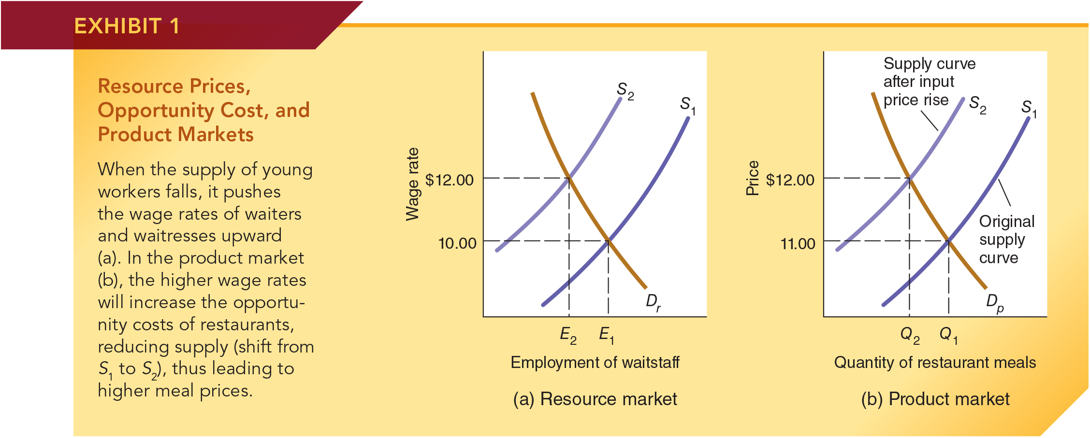
Resource Prices and Product Markets
Suppose there is a reduction in the supply of young workers that pushes restaurant waiters/waitress wages up.
Higher wages increase the restaurant’s cost, causing a reduction in supply in the product market leading to higher meal prices.
Notes:
Panel (a) When the supply of young workers falls, it pushes the wage rates of waiters and waitresses upward.
Panel (b) In the product market the higher wage rates will increase the opportunity costs of restaurants, reducing supply (shift from S1 to S2), thus leading to higher meal prices.

Slide 6
The Economics of Price Controls

Slide 7
Price Ceilings
A price ceiling establishes a maximum price that sellers are legally permitted to charge.
  Example: rent control
When a price ceiling keeps the price of a good below market equilibrium, there will be both direct and indirect effects.
  (Direct effect) Shortage: the quantity demanded will exceed the quantity supplied. Waiting lines may develop.
  (Indirect effects) Quality deterioration and changes in other non-price factors favorable to sellers and unfavorable to buyers are likely to occur.
The quantity exchanged will fall and the gains from trade will be less than if the good were allocated by markets.
Notes:
A price ceiling establishes a maximum legal price that can be charged for a good, service, or resource. Exchanges at prices above the ceiling are prohibited. Sometimes price ceilings reflect political forces wanting to keep the price of a specific item low.
The rent controls adopted by some cities provide examples of this type of price ceiling. In other cases, the price ceiling is designed to prohibit temporary increases in the price of goods. Laws prohibiting price increases during an emergency such as a hurricane or spread of a contagious virus like COVID-19 illustrate this type of price ceiling.

Slide 8
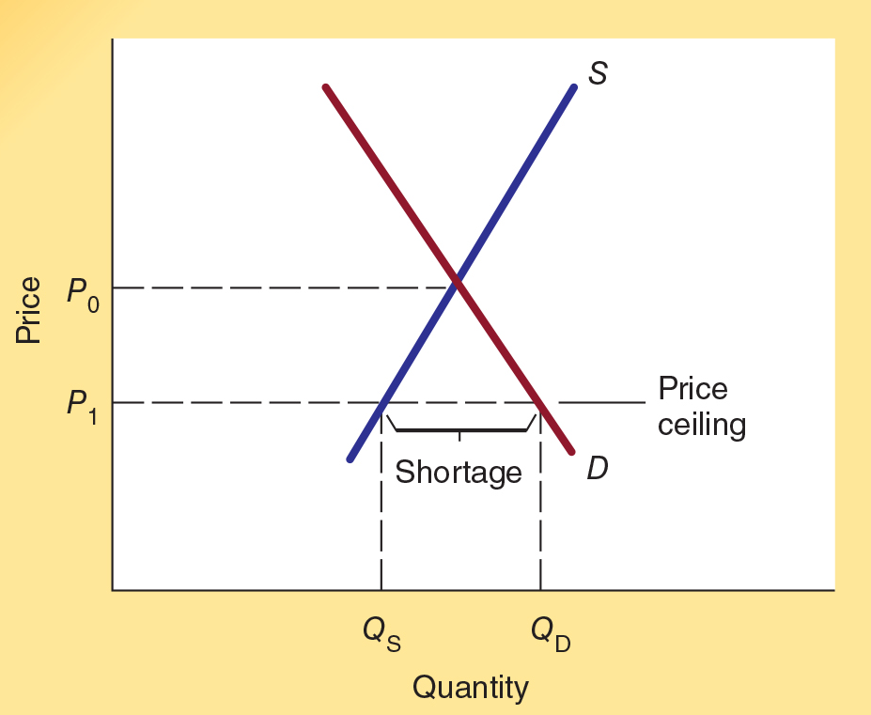
Impact of a Price Ceiling
Consider the rental housing market where the price (rent) P₀ would
bring the quantity of rental units demanded into balance with the quantity supplied.
A price ceiling like P₁ imposes a price below market equilibrium causing quantity demanded Q_{D} to exceed quantity supplied Q_{S} resulting in a shortage.
Because prices are not allowed to direct the market to equilibrium, non-price factors will become more important in determining where the scarce goods go.

Slide 9
Effects of Rent Control
Effects of Rent Control
Shortages and black markets will develop.
The future supply of housing will decline.
The quality of housing will deteriorate.
Non-price methods of rationing will increase in importance.
Inefficient use of housing will result.
Long-term renters will benefit at the expense of newcomers.
Notes:
Because rent controls push the price of rental housing below the equilibrium level, the amount of rental housing demanded by consumers will exceed the amount landlords will make available. Inevitably, rent controls that continue will lead to the following results.
Shortages and black markets will develop. Because the quantity of housing demanded will exceed the quantity supplied, some people who value rental housing highly will be unable to find it. Frustrated by the shortage, some will make under-the-table (black market) payments to secure housing.
The future supply of rental housing will decline. The below-equilibrium price will discourage entrepreneurs from constructing new rental housing units, and private investment will flow elsewhere.
The quality of rental housing will deteriorate. When apartment owners are not allowed to raise their prices, they will use quality reductions to achieve this objective.
Nonprice methods of rationing will become more important. Because price no longer rations rental housing, other forms of competition will develop.
Inefficient use of housing space will result. The tenant in a rent-controlled apartment will think twice before moving. Why? Even though the tenant might want a larger or smaller space or an apartment closer to work, he or she will be less likely to move because it will be much more difficult to find a unit that’s vacant.

Slide 10
Price Floor
A price floor establishes a minimum legal price for the
good or service.
  Example: minimum wage
When a price floor keeps the price of a good above market equilibrium, it will lead to both direct and indirect effects.
  (Direct effect) Surplus: sellers will want to supply a larger quantity than buyers are willing to purchase.
  (Indirect effects) Changes in non-price factors favorable to buyers and unfavorable to sellers.
The quantity exchanged will fall and the gains from trade will be less than if the good were allocated by markets.
Notes:
A price floor establishes a minimum price that can legally be charged. When a price floor is imposed above the current
market equilibrium price, it will alter the market’s operation. Just like a price ceiling, a price floor reduces the quantity of the good exchanged and reduces the gains from trade. As in the case of the price ceiling, nonprice factors will play a larger role in the rationing process. But because there is a surplus rather than a shortage, this time buyers will be in a position to be more selective. Buyers will purchase from sellers willing to offer them nonprice favors—better service, discounts on other products, or easier credit terms, for example.

Slide 11
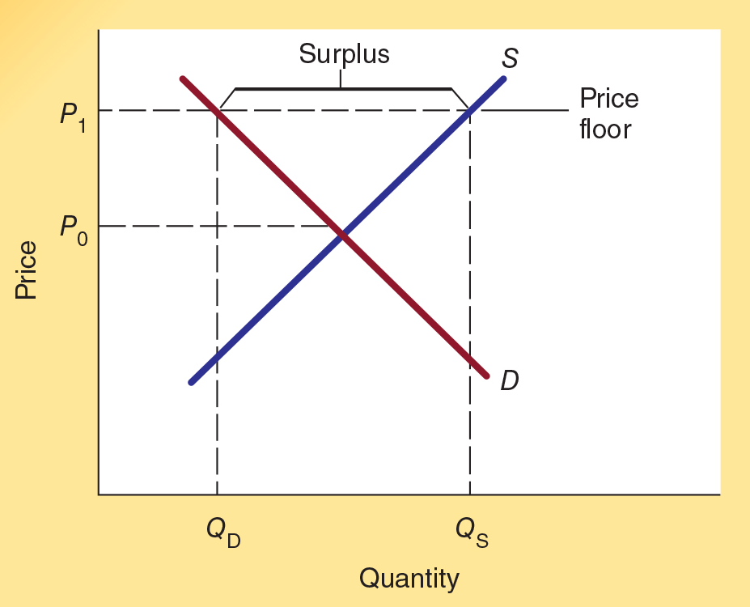
Impact of a Price Floor
A price floor like P₁ imposes a
price above market equilibrium causing quantity supplied Q_{s} to exceed quantity demanded Q_{D} resulting in a surplus.
Because prices are not allowed to direct the market to equilibrium, non-price factors will become more important in the allocation of the good.

Slide 12
Minimum Wage: An Example of a Price Floor
When the minimum wage is set above the market equilibrium for low-skill labor, the following will occur:
  Direct effect:
    Reduces employment of low-skilled labor.
  Indirect effects:
    Reduction in the non-wage components of compensation
    Less on-the-job training
    May encourage students to drop out of school
Notes:
A minimum wage is a price floor. The federal minimum wage is currently $7.25 per hour. Low-skilled and inexperienced workers whose equilibrium wage rates are lower than the minimum wage will be affected.
In a labor market, an excess supply will take the form of an abnormally high rate of unemployment. Thus, economic analysis indicates that minimum-wage legislation will lead to high unemployment rates among low-skilled workers. The exceedingly high unemployment rate of teenagers in the United States (a group with limited skills because they lack work experience) is consistent with this analysis.

Slide 13
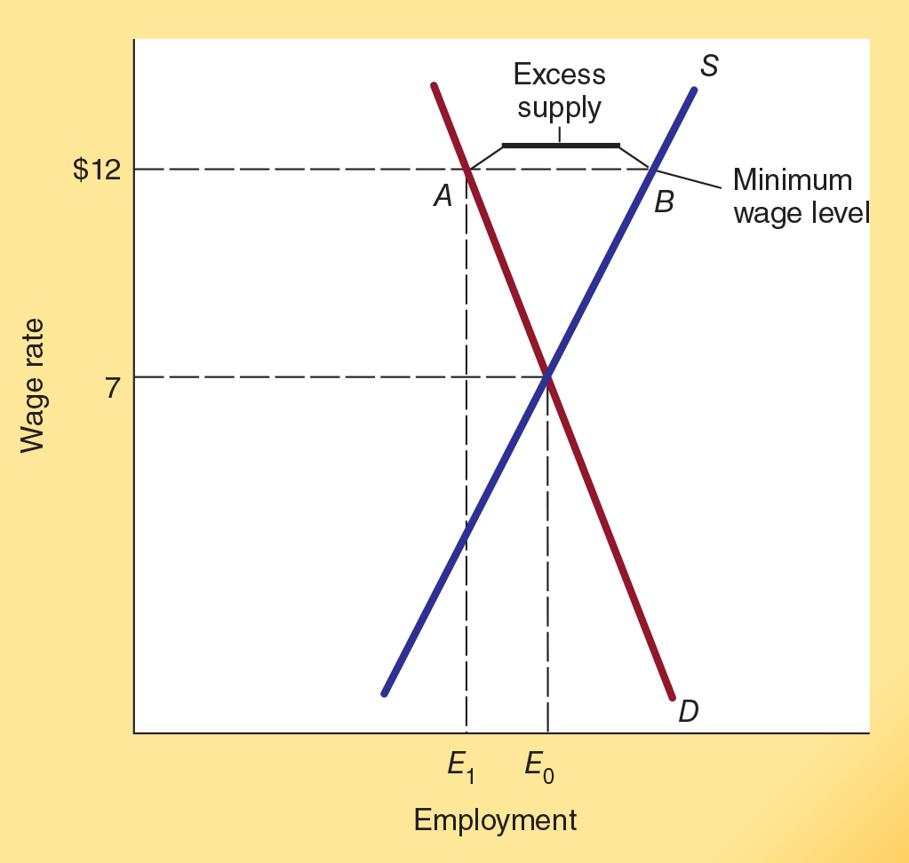
Employment and the Minimum Wage
Consider the market for low-skill labor where a price (wage) of $7 could bring the quantity of labor demanded into balance with the quantity supplied.
A minimum wage (price floor) of $12 would increase the wages of low-skill labor, but employment will decline from E₀ to E₁.
Those who lose their jobs will be pushed into either unemployment or less preferred employment.

Slide 14
Economics of the Minimum Wage
The basic postulate of economics indicates that a higher minimum wage will reduce the employment of low-skill workers.
Research indicates that each 10 percent increase in the Federal minimum wage will reduce employment by between 1 and 3 percent.
Because the wage increases are substantially larger than the reductions in employment, a higher Federal minimum wage will nearly always increase the total earnings of low-skill workers.
Proponents of minimum wages believe that the higher total earnings are worth the reductions in employment.
Notes:
Numerous studies have been conducted on the minimum wage’s impact on employment levels. It is challenging to isolate the effect of the minimum wage since other factors such as economic conditions also affect the number of workers employed. As a result, some studies find little or no effect of the minimum wage on employment levels.
However, a comprehensive survey of more than 90 studies reported that 85 percent of them found that a higher minimum wage reduces employment. These studies indicate that a 10 percent increase in the minimum wage reduces the employment of low-skilled workers by 1 to 3 percent.
Minimum-wage supporters argue that the higher wages for low-skilled workers are worth this reduction in employment and job-training opportunities. The critics disagree, arguing that if permitted to work, the low-skill workers would gain experience and training, which would facilitate their movement up the job ladder to higher wage positions.

Slide 15
Does the Minimum Wage Help the Poor?
It looks like a higher minimum wage would reduce poverty, but this view is questionable. While a higher minimum wage increases the wages of low-skill workers, their on-the-job training, non-wage benefits, working conditions, and employment will decline. Who are the minimum wage workers?
Less than 20 percent are members of households with incomes below the poverty level.
About one-half are between the ages of 16 and 24 years.
Approximately three-fifths are working part time.
Only 15 percent are a sole earner providing support for a family with one or more children.
Notes:
According to the U.S. Department of Labor, most minimum wage earners are young, part-time workers and relatively few live below the poverty line. Nearly one-half of minimum wage workers are between the ages of 16 to 24 years and approximately three-fifths hold a part-time job.
Fewer than 20 percent of minimum wage workers are from families below the poverty line, and only about one out of every four is married. Only 15 percent are a sole earner providing support for a family with one or more children.
Therefore, even if the adverse effects of a higher minimum wage on employment and training opportunities are small, a higher minimum wage does little to help the poor, making it a much less attractive antipoverty program than other alternatives.

Slide 16
City and State Minimum Wage
In 2020, twenty-nine states had minimum wage rates greater than the federal minimum. Some cities have even higher minimum rates. For example, Los Angeles, San Jose, San Francisco, Washington DC, New York City, and Seattle all have minimum wage rates of $15 or more.
The employment reductions of city and state minimum wage increases are generally larger than the federal because employers can relocate to other areas with lower minimums.
In Seattle in 2015 and 2016, the minimum wage increases were offset fully by employment reductions. Thus, there was no increase in wage payments to low-skilled workers.

Slide 17
Questions for Thought:
1. Which of the following can be expected to result from
a price ceiling that keeps the price of a product below
the market equilibrium?
(a) A surplus of the product will result.
(b) A shortage of the product will result.
(c) Changes in non-price factors that will be favorable to buyers and unfavorable to sellers will occur.
(d) Changes in non-price factors that will be favorable to sellers and unfavorable to buyers will occur.
Note: More than one option may be correct.

Slide 18
Questions for Thought:
2. How would an increase in the federal minimum wage from the current level to $15 per hour affect:
(a) Employment in skill categories previously earning less than $15 per hour
(b) The unemployment rate of teenagers
(c) Availability of on‑the‑job training for low-skill workers
(d) The demand for high‑skill workers who provide good substitutes for the labor offered by low-skill workers who are paid higher wage rates due to the increase in the minimum wage.

Slide 19
Questions for Thought:
3. Several states have laws prohibiting businesses from increasing prices in response to a natural disaster such as a hurricane or during a declared state of emergency like the COVID-19 pandemic. In what ways is this legislation like a price control? Do these laws increase or decrease the quantity of needed supplies available in the affected areas? How do they affect the efficiency with which the limited supplies are allocated?

Slide 20
Black Markets and the Importance of the Legal Structure

Slide 21
Black Markets
Black market: A market that operates outside the legal system.
The primary sources of black markets are:
Evasion of a price control
Black markets have a higher incidence of defective products, higher profit rates, and greater use of violence to resolve disputes.
Evasion of a tax (e.g. high excise taxes on cigarettes)
Legal prohibition on the production and exchange of a good (e. g., prostitution, marijuana and cocaine)
Notes:
Compared with normal markets, economic analysis indicates that black markets will be characterized by a higher incidence of defective products, higher profit rates (for those who do not get caught), and more violence.
The incidence of phony tickets purchased from street dealers selling them at illegal prices and deaths caused by toxic, illicit drugs are reflections of the high presence of defective goods in these markets. The expensive clothes and automobiles of many drug dealers provide evidence of the high monetary profits present in black markets. Crime statistics indicate that violence is often used to settle disputes arising from black-market transactions. In urban areas, a high percentage of the violent crimes, including murder, are associated with illegal trades gone bad and competition among dealers in the illegal drug market.

Slide 22
Importance of the Legal System
A legal system that provides secure property rights
and an unbiased enforcement of contracts enhances
the operation of markets.
Markets will exist in any environment, but they can be counted on to function efficiently only when property rights are secure and contracts enforced in an evenhanded manner.

Slide 23
Questions for Thought:
1. How will the operation of black markets differ from the operation of markets where property rights are clearly defined and contracts are legally enforceable?

Slide 24
The Impact of a Tax

Slide 25
Tax Incidence
The legal assignment of who pays a tax is called the statutory incidence.
  The actual burden of a tax (actual incidence) may differ substantially.
    The actual burden does not depend on who legally pays the tax (statutory incidence).
Notes:
Economists use the term tax incidence to indicate how the burden of a tax is actually shared between buyers (who pay more for what they purchase) and sellers (who receive less for what they sell).
When a tax is imposed, the government can make either the buyer or the seller legally responsible for payment of the tax. The legal assignment is called the statutory incidence of the tax. However, the person who writes the check to the government— that is, the person statutorily responsible for the tax—is not always the one who bears the tax burden.
The actual incidence of a tax may lie elsewhere. If, for example, a tax is placed statutorily on a seller, the seller might simply increase the price of the product. In this case, the buyers end up bearing some, or all, of the tax burden through the higher price.

Slide 26
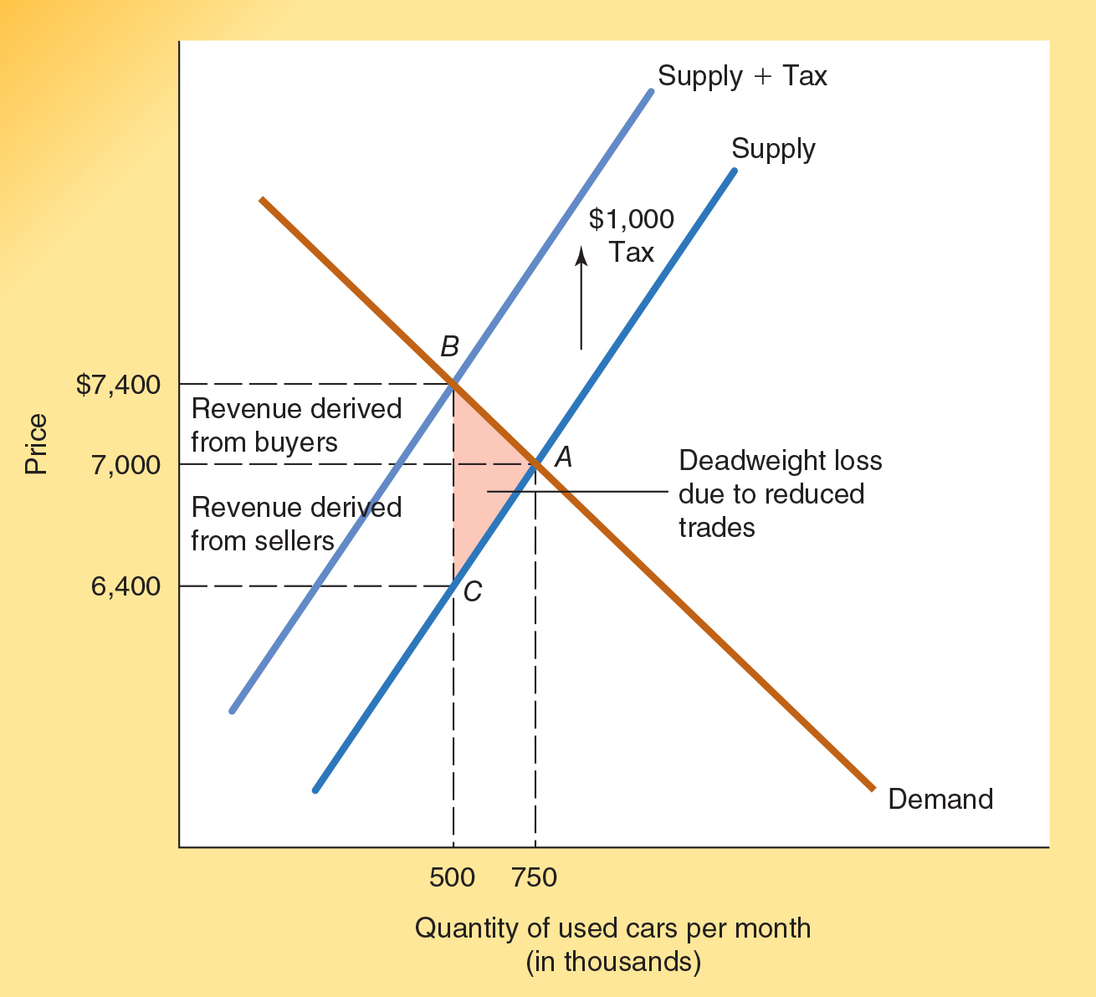
Impact of a Tax Imposed on Sellers
Consider the used car market where a price of $7,000 would bring the quantity of used cars demanded into balance with the quantity supplied.
When a $1,000 tax is imposed on the sellers of used cars, the supply curve shifts vertically upward by the amount of the tax.
The new price for used cars is $7,400, sellers netting $6,400 ($7,400 - $1000 tax).
Consumers end up paying $7,400 instead of $7,000 and bear $400 of the tax burden.
Sellers end up receiving $6,400 (after taxes) instead of $7000 and bear $600 of the tax burden.

Slide 27
Impact of a Tax Imposed on Sellers
The new quantity of used cars that clears the market is 500,000.
Consumers bear $400 of the tax burden and, as there are 500,000 units sold per month, tax revenues derived from consumers (upper rectangle) = $200,000,000.
Sellers bear $600 of the tax burden and so, as there are 500,000 units sold per month, tax revenues derived from the sellers (lower rectangle) = $300,000,000.
As only 500,000 cars are sold after the tax (instead of 750,000), the shaded red triangle above the old supply curve and below the demand curve represents the consumer and producer surplus lost from the levying of the tax, called the deadweight loss to society.

Slide 28
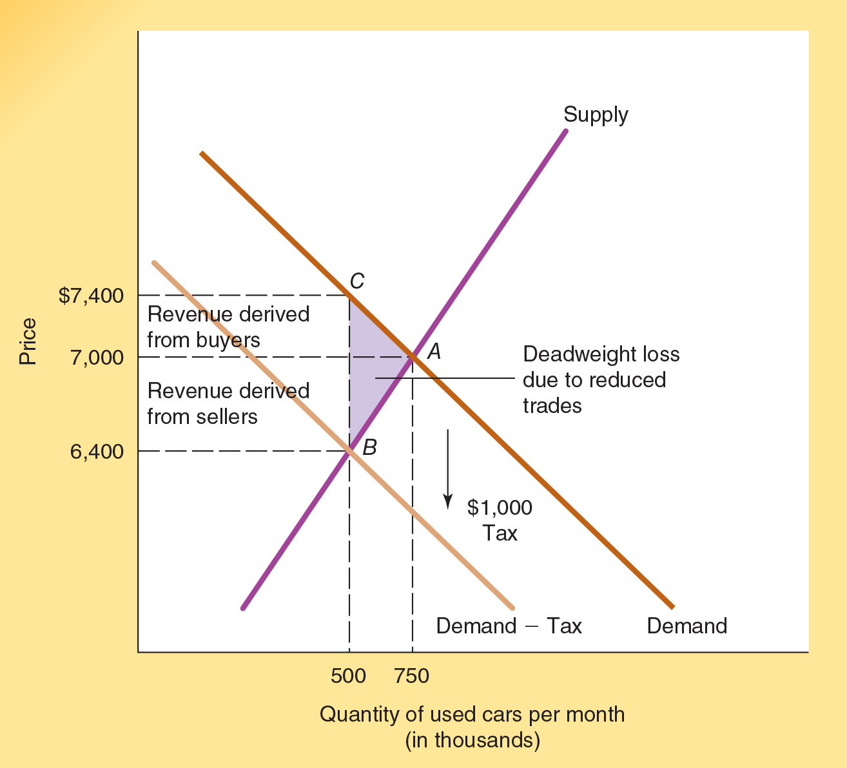
Impact of a Tax Imposed on Sellers
Suppose the $1,000 tax was levied on buyers rather than the sellers.
When a $1,000 tax is imposed on buyers of used cars, the demand curve shifts vertically downward by the amount of the tax.
The new price for used cars is $6,400.
Buyers then pay taxes of $1,000 making the after tax price $7,400.
Consumers end up paying $7,400 (after taxes) instead of $7,000 and bear $400 of the tax burden.
Sellers end up receiving $6,400 instead of $7,000 and bear $600 of the tax burden.

Slide 29
Impact of a Tax Imposed on Sellers
The new quantity of used cars that clears the market is 500,000.
Consumers bear $400 of the tax burden and, as there are 500,000 units sold per month, tax revenues derived from consumers (upper rectangle) = $200,000,000.
Sellers bear $600 of the tax burden and, as there are 500,000 units sold per month, tax revenues derived from the sellers (lower rectangle) = $300,000,000.
The violet shaded triangle above the supply curve and below the old demand curve represents consumer and producer surplus lost due to the tax–the deadweight loss to society.
The incidence of the tax is the same regardless of whether it is imposed on buyers or sellers.

Slide 30
Deadweight Loss
The deadweight loss of taxation is the loss of the gains from trade as a result of the imposition of a tax.
It imposes a burden of taxation over and above the burden of transferring revenues to the government.
It is composed of losses to both buyers and sellers.
The deadweight loss of taxation is sometimes referred to as the “excess burden of the tax.”
Notes:
Remember, trade results in mutual gains for both buyers and sellers. The loss of the mutual benefits that would have been derived from the sale of additional units of the good also imposes a cost on buyers and sellers. But this cost—the loss of the gains from trade eliminated by the tax—does not generate any revenue for the government.
Economists call this the deadweight loss of taxation. The deadweight loss is a burden imposed on buyers and sellers over and above the cost of the revenue transferred to the government. Sometimes it is referred to as the excess burden of taxation. It is composed of losses to both buyers (the lost consumer surplus) and sellers (the lost producer surplus).
The deadweight loss to sellers includes an indirect cost imposed on the people who supply resources to that industry (such as its suppliers and employees).

Slide 31
Elasticity and Incidence of a Tax
The actual burden of a tax depends on the elasticity of supply relative to demand.
As supply becomes more inelastic, more of the burden will fall on sellers and resource suppliers.
As demand becomes more inelastic, more of the burden will fall on buyers.
Notes:
Economic analysis indicates that the actual burden of a tax—or more precisely, the split of the burden between buyers and sellers—does not depend on whether the tax is statutorily placed on the buyer or the seller.
The incidence of a tax depends on the responsiveness of buyers and of sellers to a change in price. When buyers respond to even a small increase in price by leaving the market and buying other things, they will not be willing to accept a price that is much higher than it was prior to the tax.
Similarly, if sellers respond to a small reduction in what they receive by shifting their goods and resources to other markets, or by going out of business, they will not be willing to accept a much smaller payment, net of tax. The burden of a tax tends to fall more heavily on whichever side of the market has the least attractive options elsewhere—the side of the market that is less sensitive to price changes, in other words.

Slide 32
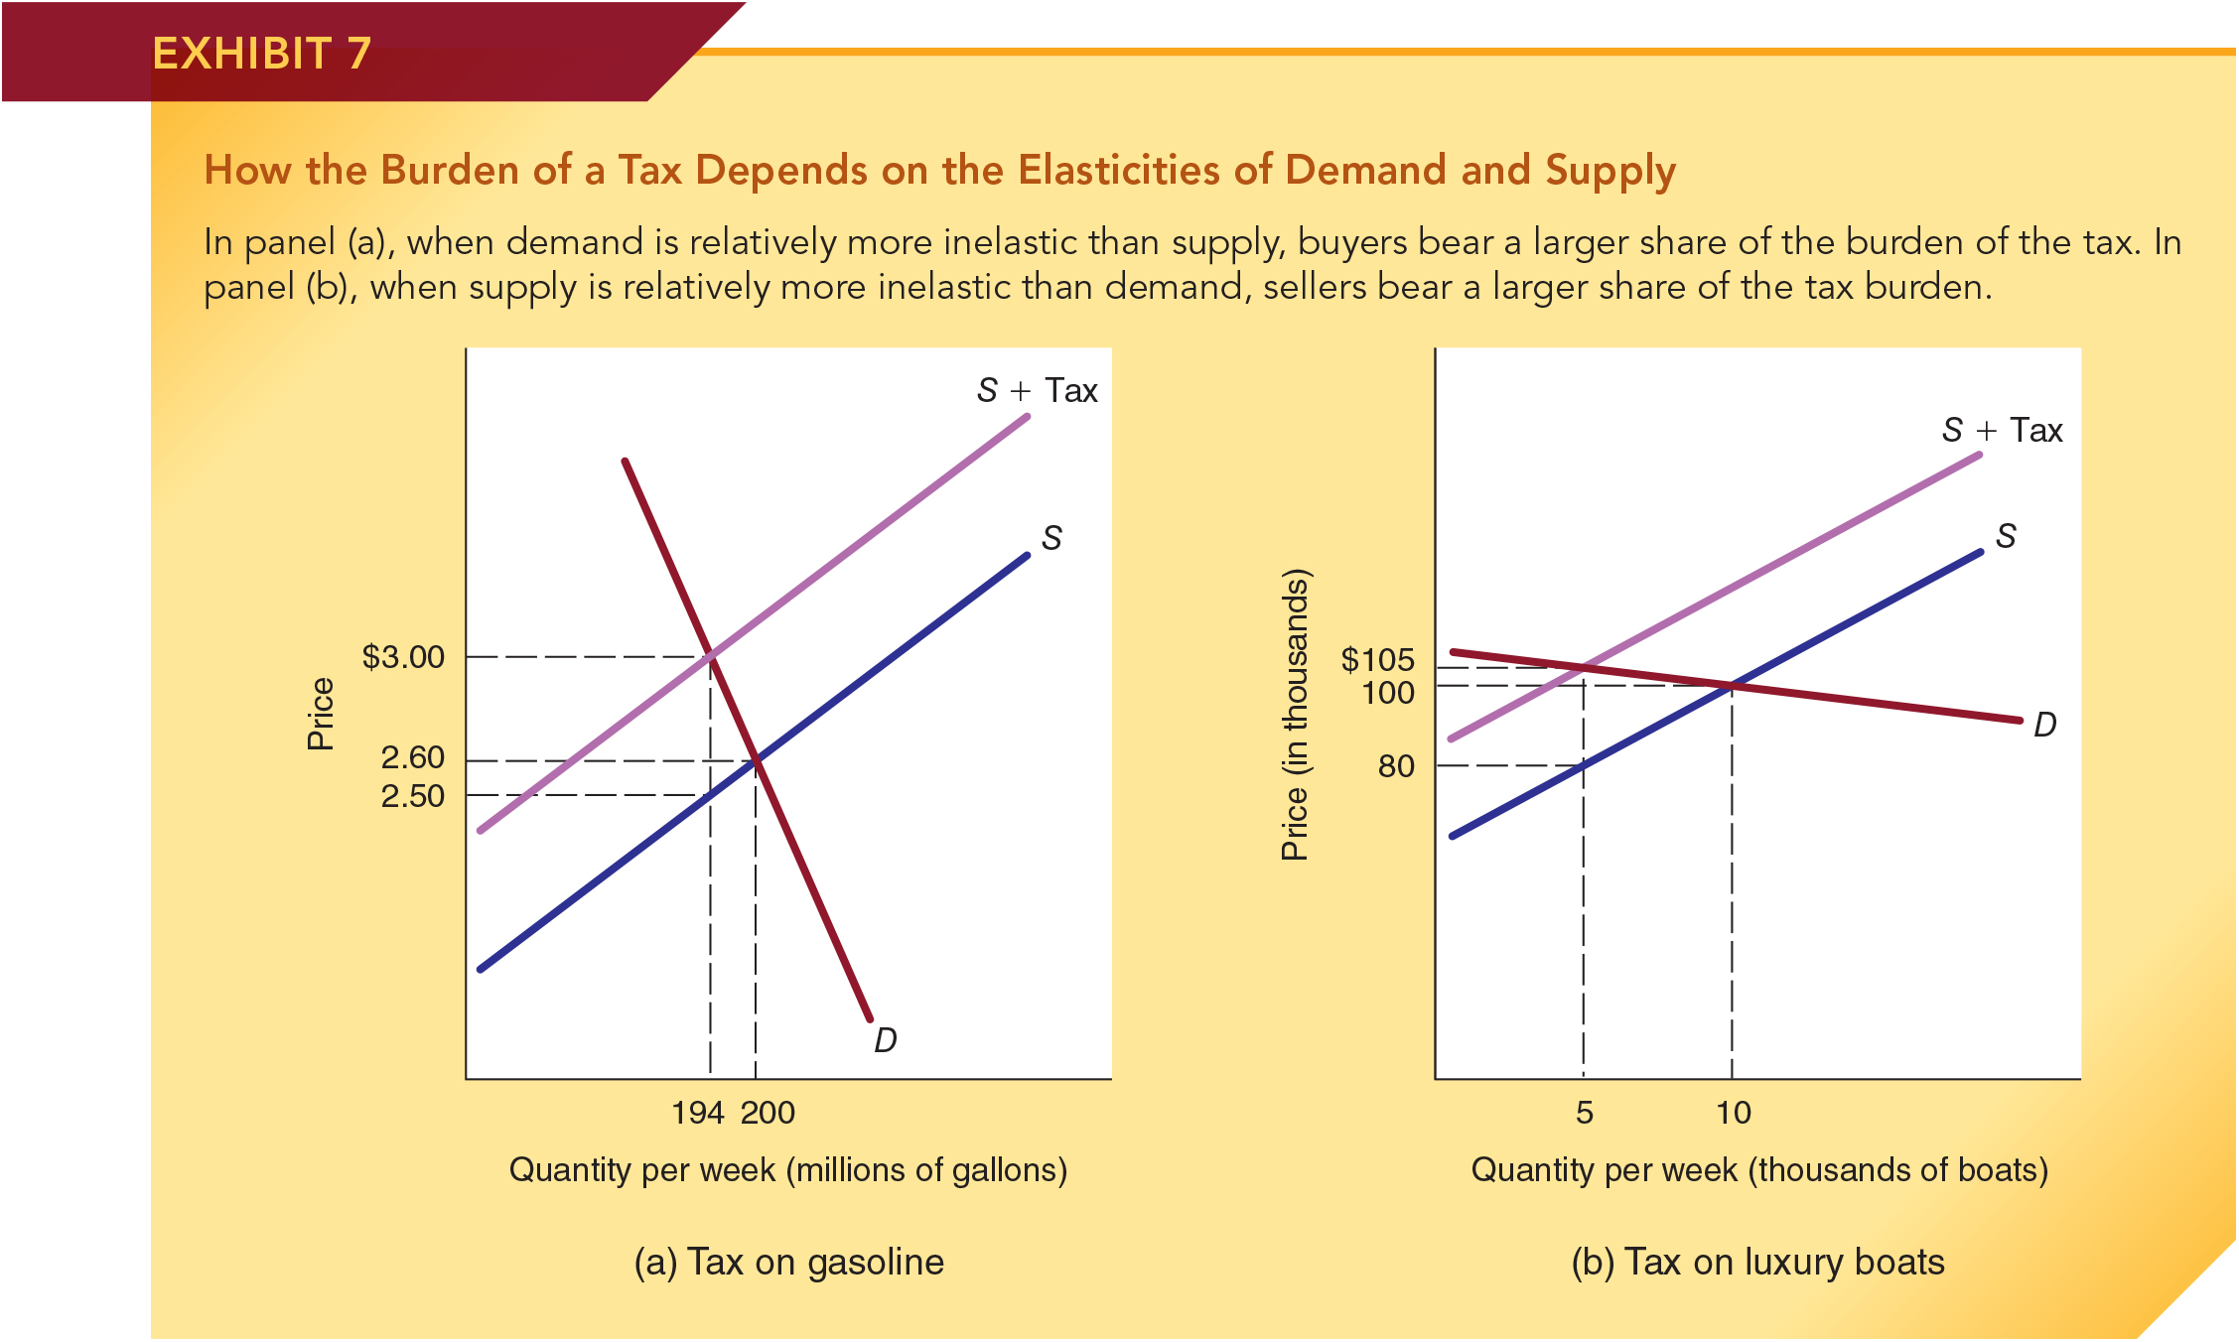
Impact of a Tax Imposed on Sellers
Consider the markets for gasoline and luxury boats, each in equilibrium.
If we impose a $0.50 tax on gasoline suppliers, the supply curve moves vertically by the amount of the tax. Price goes up $0.40 and output falls by 6 million gallons per week.
If we impose a $25K tax on luxury boat suppliers, the supply curve moves up by the amount of the tax. Price goes up by $5K and output falls by 5 thousand units.
In the gasoline market, the demand is relatively more inelastic than its supply; hence, buyers bear most of the tax ($0.40 of the $0.50 tax).
In the luxury boat market, the supply is relatively more inelastic than its demand; hence, sellers bear most of the tax ($20k of the $25k tax).

Slide 33
Tax Rates, Tax Revenues, and the Laffer Curve

Slide 34
Average Tax Rate
The average tax rate equals tax liability divided by taxable income.
A progressive tax is one in which the average tax rate rises with income.
A proportional tax is one in which the average tax rate stays the same across income levels.
A regressive tax is one in which the average tax rate falls with income.

Slide 35
Marginal Tax Rate
The marginal tax rate is calculated as the change in tax liability divided by the change in taxable income.
The marginal tax rate is highly important because it determines how much of an additional dollar earned must be paid in taxes (and therefore, how much one gets to keep). In this way, the marginal tax rate directly impacts an individual’s incentive to earn.
Notes:
An individual’s marginal tax rate can be very different from his or her average tax rate.
The marginal tax rate reveals both how much of one’s additional income must be turned over to the tax collector and how much is retained by the individual taxpayer.

Slide 36
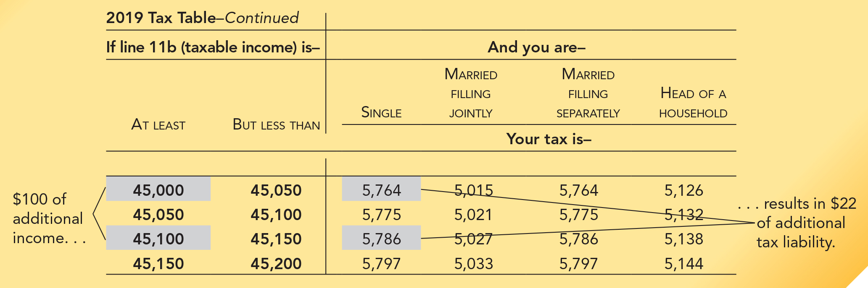
Marginal and Average Tax Rate: An Application
An excerpt from the 2019 federal income tax table is shown here.
Note, for single individuals, as income increases from $45,000 to $45,100 their tax liability increases from $5,764 to $5,786.
In this range, what is the individual’s marginal tax rate?
What is the individual’s average income tax rate?

Slide 37
Tax Rate and Tax Base
Tax rate:
Defined as the rate (%) at which an activity is taxed.
Tax base:
The level or quantity of an economic activity that is taxed.
Tax revenues:
Defined as tax rate multiplied by tax base.
Note: Higher tax rates reduce the level of the tax base because they make the activity less attractive.

Slide 38
Laffer Curve
The Laffer Curve (next slide) illustrates the relationship between tax rates and tax revenues.
As tax rates increase from low levels, tax revenues will also increase even though the tax base is shrinking.
As rates continue to increase, at some point, the shrinkage in the tax base will dominate and the higher rates will lead to a reduction in tax revenues.
The Laffer Curve shows that tax revenues are low for both high and low tax rates.
Notes:
Economist Arthur Laffer popularized the idea that, beyond some point, higher tax rates will shrink the tax base so much that tax revenue will eventually decline as tax rates are pushed to higher and higher levels. The curve illustrating the relationship between tax rates and tax revenues is called the Laffer curve.

Slide 39
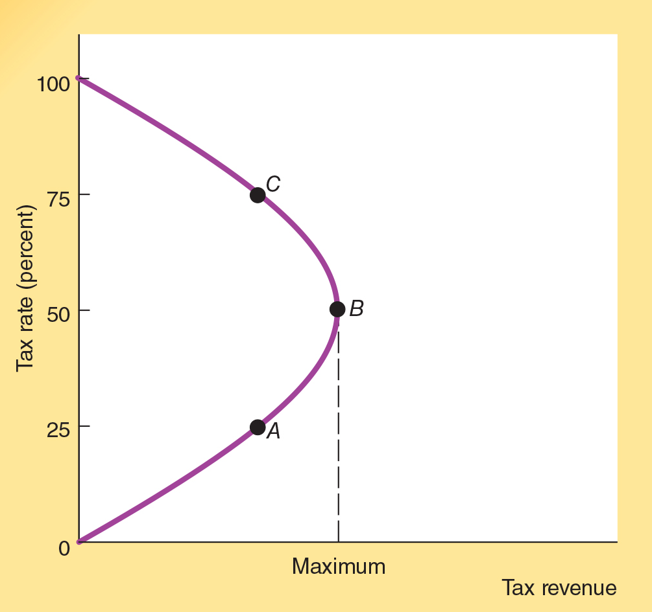
The Laffer Curve
At a tax rate of 0%, no taxes would be paid and, so, tax revenues would equal to $0.
At a tax rate of 100%, nobody would work, and so, tax revenues would be equal to $0.
As the tax rate increases from 0% to some level like A, tax revenues increase despite the fact that some individuals work less.
As rates continue to increase (beyond B, for example), higher rates will eventually cause revenues to fall.
Still higher tax rates will lead to even less tax revenue (from B to C and beyond). This is because the tax base shrinks faster than tax revenues increase from higher tax rates.
There is no presumption that the level of the tax rate at B is the ideal tax rate, only that B maximizes tax revenue in the current period.

Slide 40
Laffer Curve and Tax Changes in the 1980s
During the 1980s, the top Federal marginal income tax rate fell from 70% to 33%.
It is important to distinguish between changes in tax rates and changes in tax revenues.
Even though the top Federal income tax rates were cut sharply during the 1980s, the tax revenues and the share of personal income tax paid by high earners rose during the decade.
Notes:
Evidence from the sharp reduction in marginal tax rates imposed on those with high incomes during the 1980s supports the Laffer curve. The top marginal rate was reduced from 70 percent at the beginning of the decade to 33 percent by the end of the decade. Even though the top rates were cut sharply, tax revenues and the share of the personal income tax paid by high-income earners actually rose as a result.
During the decade, revenue collected from the top 1 percent of earners rose a whopping 51.4 percent (after adjusting for inflation). In 1980, 19 percent of the personal income tax was collected from the top 1 percent of earners. By 1990, at the lower tax rates, the top 1 percent of earners accounted for more than 25 percent of income tax revenues. The top 10 percent of earners paid just over 49 percent of total income taxes in 1980, but by 1990 the share paid by these earners had risen to 55 percent. Thus, the reduction in the exceedingly high rates increased the revenue collected from high-income taxpayers.

Slide 41
The Impact of a Subsidy

Slide 42
Impact of a Subsidy
A subsidy is a payment to either the buyer or seller of a good, usually on a per unit basis.
The supply and demand framework can be used to analyze the impact of a subsidy as it was used to analyze the impact of a tax.
As in the case of a tax, the division of the benefit from a subsidy is determined by the relative elasticities of demand and supply rather than to whom the subsidy is actually paid.
When supply is highly inelastic relative to demand, sellers will derive most of the benefits of a subsidy.
When demand is highly inelastic relative to supply, the buyers will reap most of the benefits of a subsidy.
Notes:
When a subsidy is granted to buyers, proponents typically argue that the subsidy will make the purchase of the good more affordable. Correspondingly, subsidies to sellers are generally thought to improve the profitability of the producers in the industry.
As we have seen in other cases, however, the effect of government programs often differ substantially from the stated intentions of their proponents. Because prices change when subsidies are imposed (just as when taxes are imposed), the benefit of a subsidy can be partially, or totally, shifted from buyer to seller, or vice versa.

Slide 43
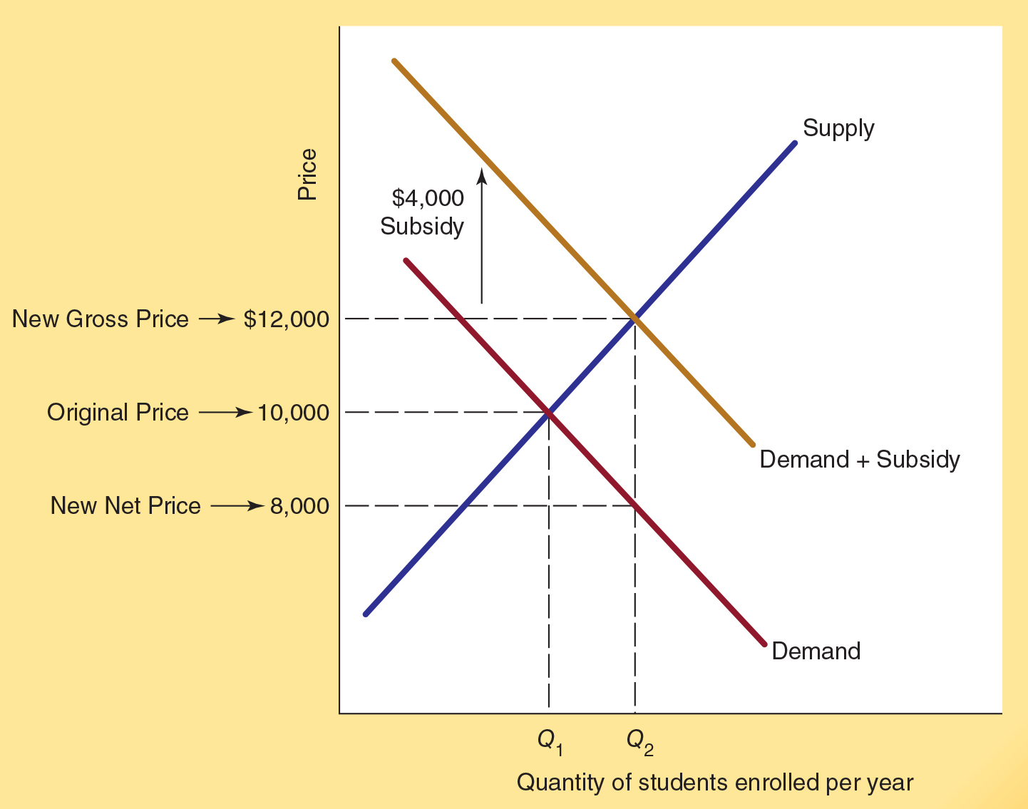
Impact of a Subsidy Granted to Buyers
Who benefits when government subsidizes college students – the student or the college?
When a $4,000 per year tuition subsidy is granted to students, the demand for college shifts vertically by the amount of the subsidy.
The equilibrium price for college rises from P₁ = $10,000 to P₂ = $12,000 (the new gross price for students).
With the $4,000 subsidy, the net price paid by the subsidized students is $8,000 per year (a gain of $2,000 for them).
Colleges also benefit from the tuition subsidy through higher prices for their services (P₂ is $2,000 higher than before the subsidy).

Slide 44
Real World Subsidy Programs
There are now approximately 2,300 federal subsidy programs, more than twice the number of the mid-1980s.
The primary beneficiaries of subsidy programs are often different than the group receiving the subsidy.
  For example, suppliers derive substantial benefits when the purchasers are subsidized, particularly when the supply of the service is highly inelastic
When subsidies are granted to some (the elderly, the poor, certain college students, etc.) but not others the group that is not subsidized is generally harmed. They often have to pay higher prices than would otherwise be the case.
Notes:
Many subsidy programs are driven by political considerations—the desire of politicians to favor various groups, particularly those that are well organized, in exchange for their votes and other forms of political support. Moreover, the subsidies often generate harmful secondary effects.
Subsidized firms are encouraged to spend more time lobbying politicians and less time pleasing customers. They are also encouraged to undertake wasteful projects that fail to generate revenue sufficient to cover costs.

Slide 45
Real World Subsidy Programs
Two examples:
Grants and loans to college students have grown substantially in recent decades. While these subsidies have helped students pay for college, they have also driven up the cost of college.
Subsidies to college students:
Health care subsidies:
Subsidies to health care consumers have driven up the cost of health care. Health care prices have risen at twice the rate of other prices since the passage of Medicare and Medicaid.

Slide 46
Real World Subsidy Programs
Politicians often us subsidy programs to obtain votes and political contributions from interest groups benefiting from the subsidies.
Subsidized firms are encouraged to spend more time lobbying politicians and less time pleasing customers.
The subsidies often generate harmful secondary effects.
They are also encouraged to undertake wasteful projects that fail to generate revenue sufficient to cover costs.

Slide 47
Questions for Thought:
1. The Laffer Curve indicates that:
(a) an increase in tax rates will always lead to an increase
in tax revenues.
(b) when tax rates are low, an increase in tax rates will generally lead to a reduction in tax revenues.
(c) when tax rates are high, a rate reduction may lead to an increase in tax revenue.
(d) the deadweight losses resulting from taxation are small at the tax rate that maximizes the revenues derived by the government.

Slide 48
Questions for Thought:
2. The burden of a sales (excise) tax imposed on a product will fall primarily on buyers when:
(a) the demand for the product is highly inelastic and supply is relatively elastic.
(b) the demand for the product is highly elastic and the supply is relatively inelastic.
(c) the tax is legally imposed on the seller.
(d) the tax is legally imposed on the buyer.

Slide 49
Questions for Thought:
3. “We should impose a 20% luxury tax on expensive cars (those with a sales price of more than $80,000) in order to collect more tax revenue from the wealthy.” Will the burden of such a tax fall primarily on the wealthy? Explain.
4. Several cities and states have recently increased the taxes they levy on cigarettes by a dollar or more per pack. How will these taxes affect:
(a) the quantity of cigarettes sold in the city or state,
(b) the tax revenues collected from the tax,
(c) the incidence of smoking?

Slide 50
Questions for Thought:
5. The price of a ticket to the Super Bowl typically averages approximately $2,500. Seeking to make the tickets more affordable for ordinary Americans, suppose the government provides a $2,000 subsidy to the ticket purchasers.
(a) What impact will the subsidy have on the price of the tickets?
(b) Who will be the major beneficiary of this subsidy?

Slide 51
End of Chapter 4

